Slide 1
COVID-19
Vaccine Data Analysis
Jay Laxami
Soujanya Pentyala
Jess Van Dame
Chris Winn

Slide 2
INTRODUCTION
COVID-19 remains a global health emergency
Pandemic is now in a transition phase
Access to treatments and vaccinations across 178 countries and 11 different vaccine types has significantly reduced health complications and deaths
In U.S., Biden administration plans to end national health emergency on May 31, 2023
Notes:
Jess

Slide 3
DATA ANALYSIS
Examination of data related to COVID-19 vaccinations in the United States
What are the vaccination totals by country?
What are the U. S. vaccination totals by state?
How many people in each state are fully vaccinated?
Notes:
Jess

Slide 4
TABLE OF CONTENTS
01.
02.
03.
04.
DATA SOURCE
APPROACH
VISUALIZATIONS
CONCLUSIONS

Slide 5
01
DATA SOURCE

Slide 6
DATA SOURCE
Abundant vaccine data exists
Readily available
Data Sources:
https://www.kaggle.com/datasets/paultimothymooney/usa-covid19-vaccinations
https://ourworldindata.org/covid-vaccinations
Notes:
Jay

Slide 7
02
APPROACH

Slide 8





APPROACH
Clean data
Create dataframe for U.S. and world data
Used PostgresSQL as database
SQLAlchemy
Flask API
D3 JSON
Notes:
Jay

Slide 9
03
VISUALIZATIONS

Slide 10
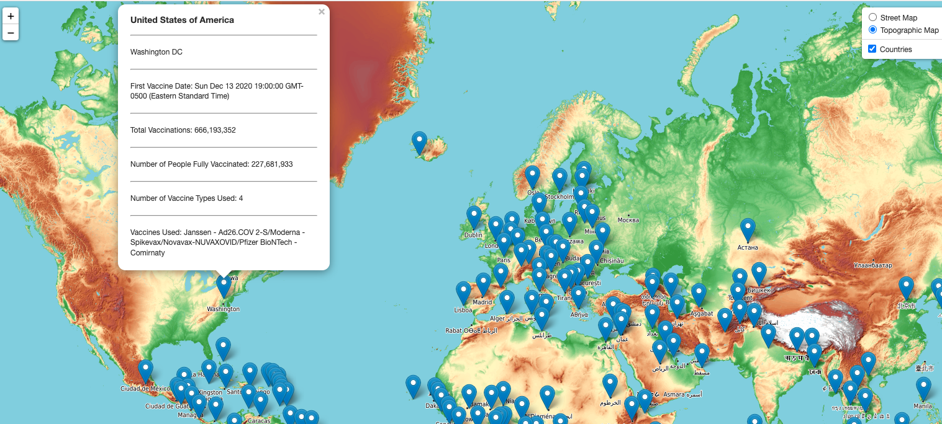
World Vaccination Map
Notes:
Jess

Slide 11
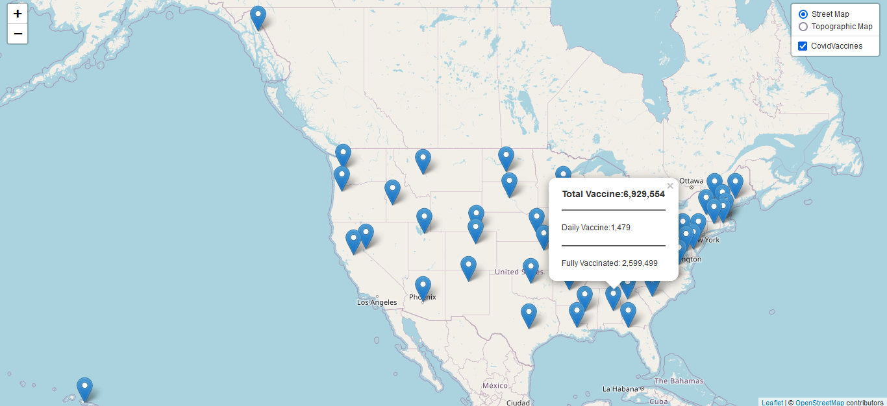
U.S. Vaccination Map
Notes:
Jay

Slide 12
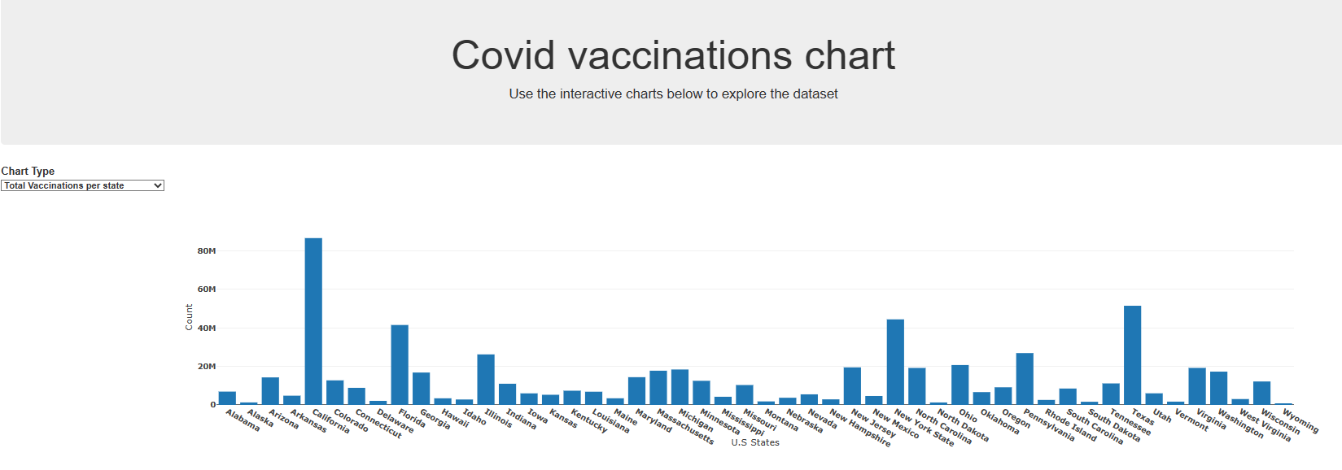
U.S.- Total Vaccinations by State

Slide 13
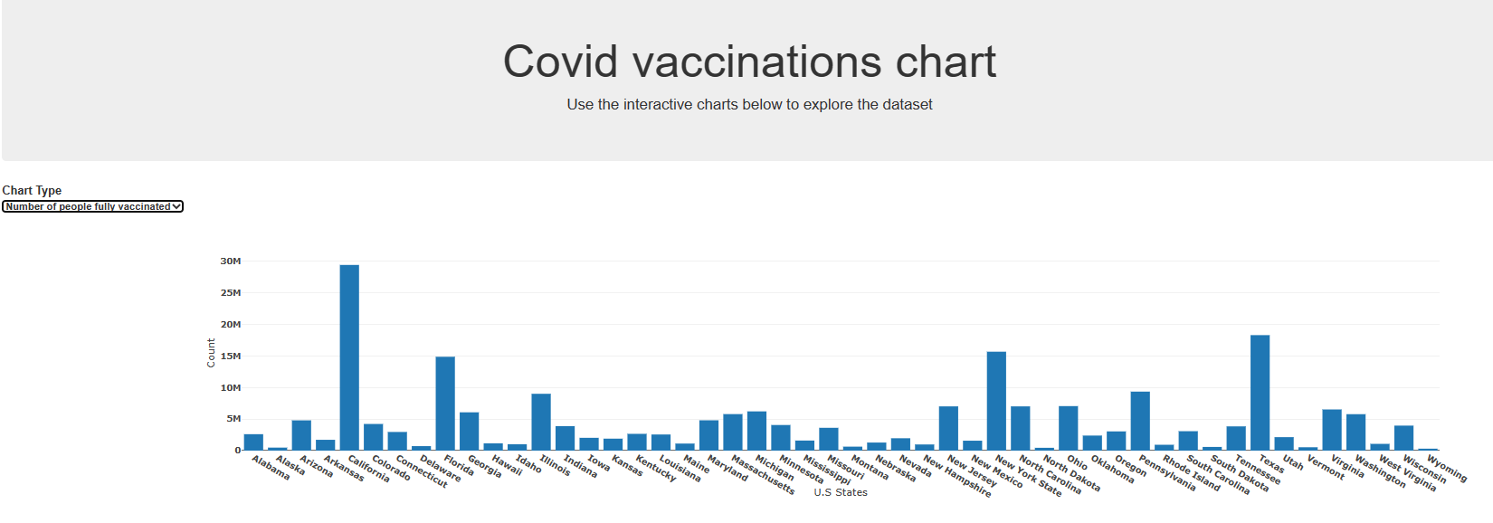
U.S.- Fully Vaccinated by State

Slide 14
04
CONCLUSIONS
Notes:
Chris

Slide 15
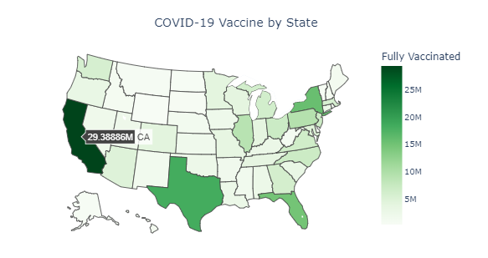
People Fully Vaccinated
Notes:
Jay

Slide 16
QUESTIONS?

